Slide 1


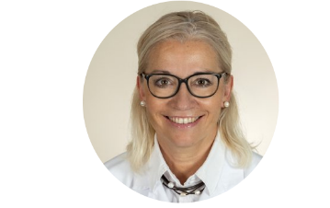


Your Partner for eHealth
Digital healthcare in the
private environment
Prof Dr. med. Christiane Brockes
alcare Co-Founder & CEO
Clinical Telemedicine / eHealth, University Zurich
EKTG Webinar June 24. 2020

Slide 2
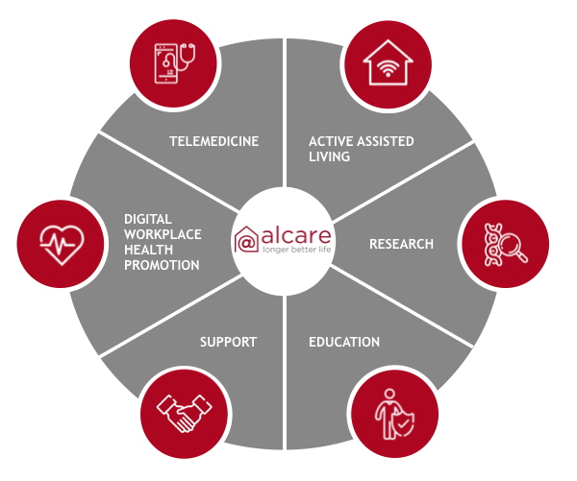
Your Partner for eHealth
More autonomy
More health
More life-quality
eHealth for:
Seniors facilities
Hospitals & medical practices
Municipalities
Enterprises
EKTG Webinar June 24. 2020

Slide 3

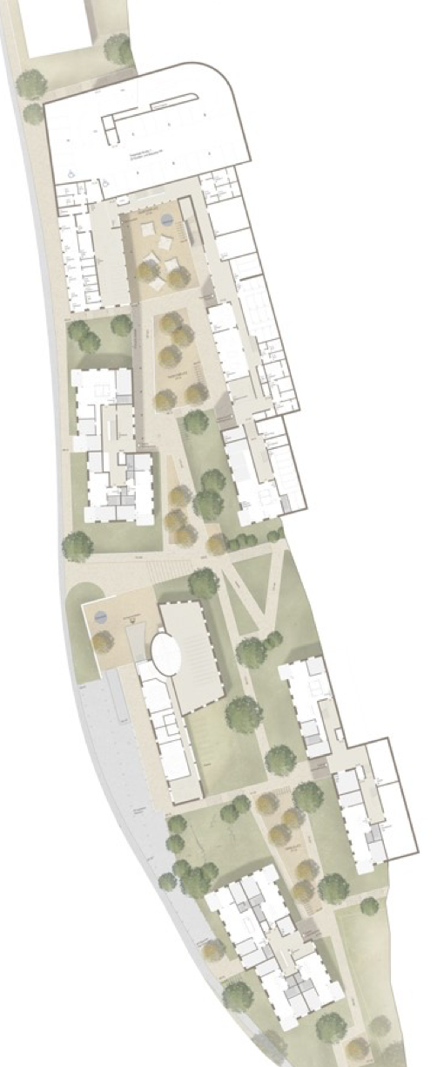
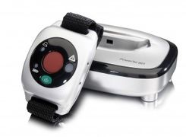
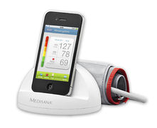
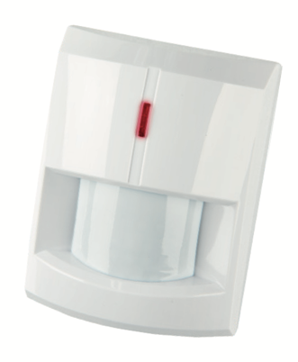
Example from Switzerland: Project
«ThurvitaTech»
Better health, safety and quality of life
35 Apartments for the elderly
Live independently and safely
Modular solutions and flexible integration
EKTG Webinar June 24. 2020

Slide 4
Example from Switzerland: Project
«ThurvitaTech»
Our approach
Workshop «Perspectives of Active Assisted Living»
Needs assessment and strategy development
Selection process for suitable AAL technologies and services
Implementation and education of the medical professionals and end users
Evaluation of selected digital solutions
Advantages
More health, safety and autonomy for tenants
Support and relief to the nursing staff Optimisation of support processes
Contemporary service offerings (to the community)
EKTG Webinar June 24. 2020

Slide 5

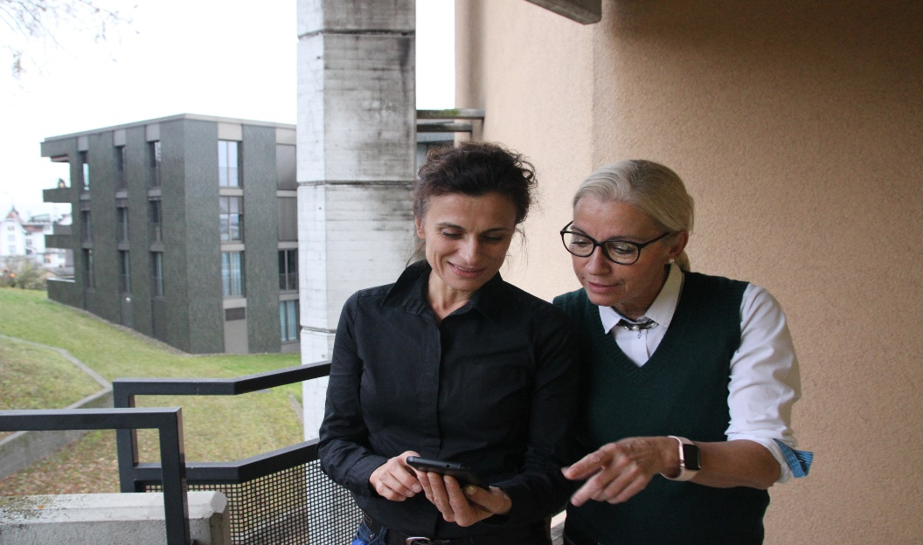
Example from Switzerland: Project
«ThurvitaTech»
  Structured training for nurses:
  The aim of the further training is to develop skills and learn how to use the digital assistance systems safely.
EKTG Webinar June 24. 2020

Slide 6

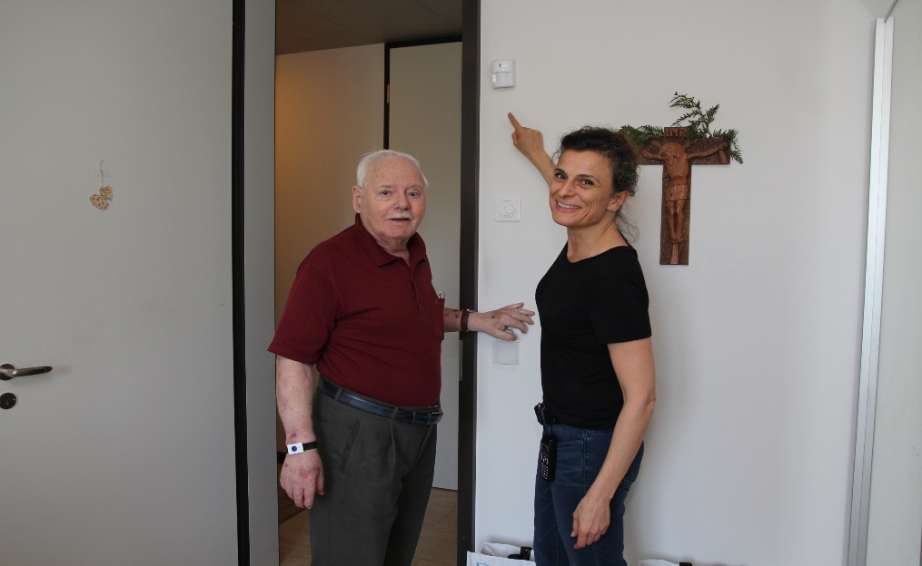
Example from Switzerland: Project
«ThurvitaTech»
  Accompanying and supporting tenants (regular home visits / phone calls, etc.)
  is the key to the successful use of new health technologies.
  Creating acceptance, trust and joy is central to successful use.
EKTG Webinar June 24. 2020

Slide 7
For a life with more
self-determination, safety and quality of life
Prof Dr. med. Christiane Brockes
alcare Co-Founder & CEO
Clinical Telemedicine / eHealth, University Zurich
EKTG Webinar June 24. 2020

