Slide 1
The European Knowledge Tree Group (EKTG) with AAL
The Value of the Silver Economy using the Gold of the Future
Nicola Filizola, Communication and Public Affairs Manager, AAL Programme
Was Alain Thielemans - Flanders innovation & entrepreneurship
at@vlaio.be

Slide 2
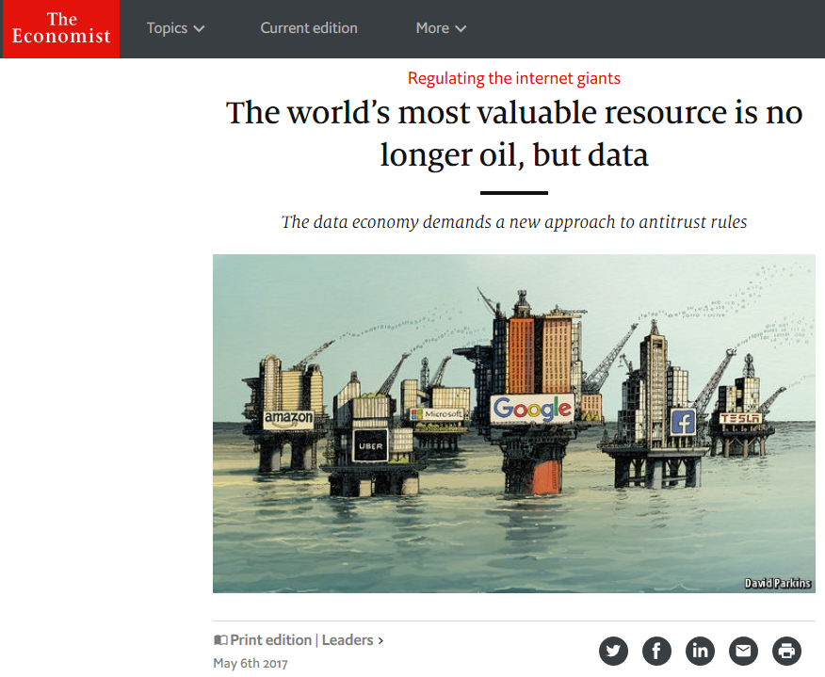

Slide 3
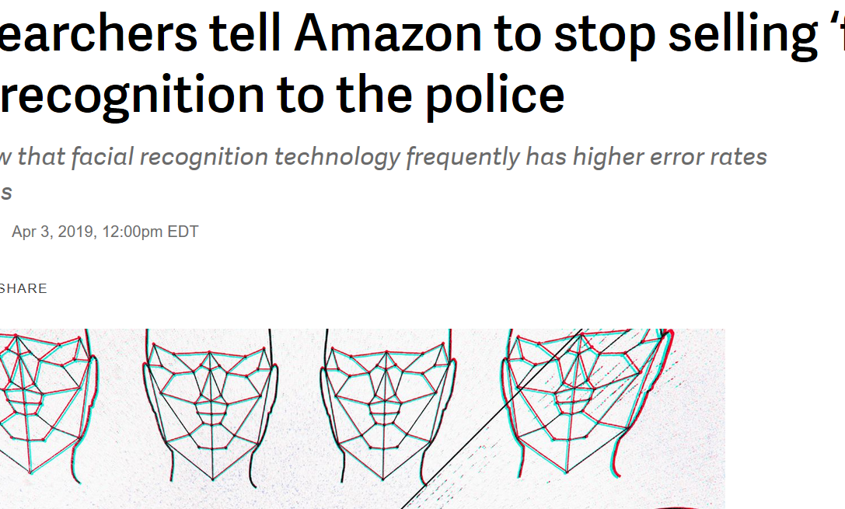
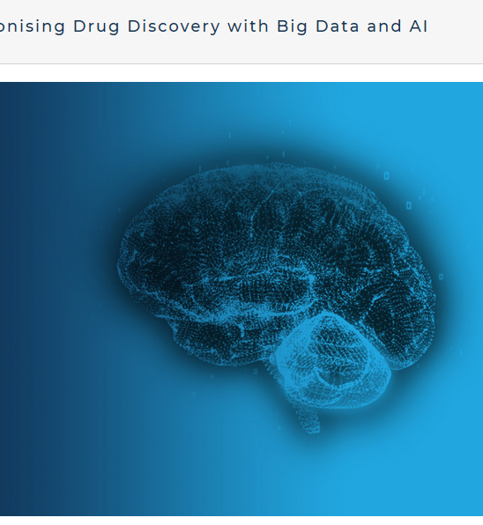
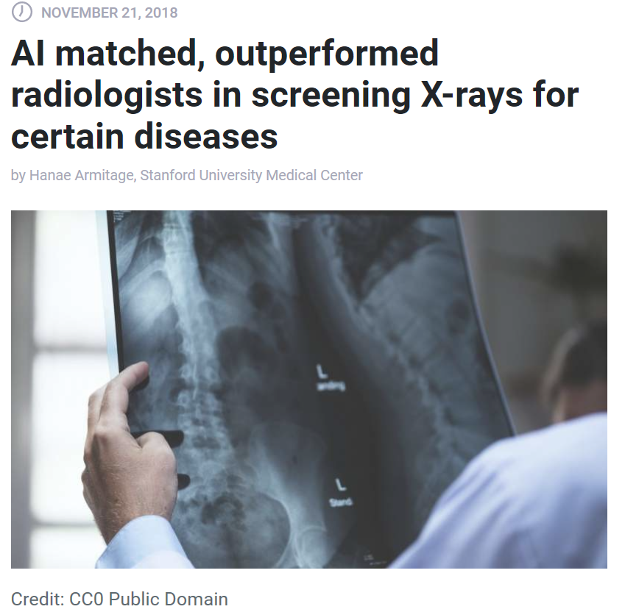
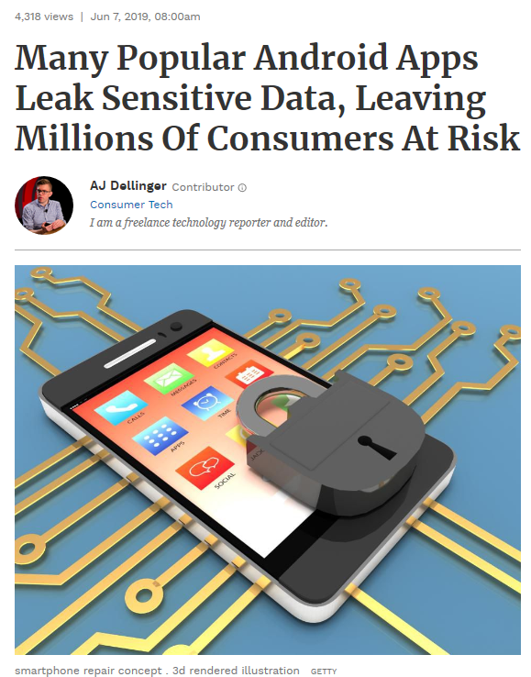
The good, the bad and the ugly

Slide 4
I don’t like the fact that companies are not open about the data they have about me
It’s OK to share personal data as long as I get something in return
9%
21%
45%
Source: imec digimeter 2018

Slide 5
Analytic options can be categorised at a high level into three distinct types. No one type of analytic is better than another, they co-exist and complement each other.
Descriptive Analytics, which use data aggregation and data mining to provide insight into the past and answer: “What has happened?”
Predictive Analytics, which use statistical models and forecasts techniques to understand the future and answer: “What could happen?”
Prescriptive Analytics, which use optimisation and simulation algorithms to advice on possible outcomes and answer: “What should we do now?”
So we want to help you to decide how to handle Data so it is practical for You, Your Staff, and your Users!
Some people have encouraged User independence to create cost effective services
As funding is frequently limited this is essential in good practice.
Workshop 1 24th September, 2019, AAL Forum, Aarhus, Denmark

Slide 6
This raises questions
Is bigger data always better data?
Do organisations have the absorptive capacity needed?
Do they have the development capability?
Big Data is not ‘a free lunch’, so who pays?
Have you got the Leadership, Talent management, and Decision-making skills?
How do you know Users’ views?

Slide 7
Today’s format
Introduction
5x5 minutes Presentations
30 minutes debate
3x1 minutes Commentary presentations
5 minute Debate
Debate round tables 10 minutes
Conclusions & closing

Slide 8
Contributions from
Paul Timmers - Chief Advisor EIT Health, Visiting Fellow Oxford University
Rait Kuuse - Deputy Secretary General for Social Policy, Estonia
George MacGinnis - Challenge Director, Healthy Ageing, UK Research and Innovation.
Henk- Herman Napp - Senior Researcher, Vilans Company and Technische Universiteit, Eindhoven, Netherlands
Christiane Brockes - CEO alcare Wil, lectureship University Zurich “Clinical Telemedicine / eHealth”, Switzerland
John McGrory - School of Electrical & Electronic Engineering, Dublin
Dirk Lukkien - Senior Researcher at Vilans, PhD student AI in long-term care, Rivierenwijk, Overijssel Province, Netherlands
Frederic Ehrler - Hôpitaux Universitaires de Genève, HUG · Medical Information
Maggie Ellis - EKTG Coordinator

