Slide 1
The European Knowledge Tree Group (EKTG) with AAL
The Value of the Silver Economy using the Gold of the Future
George MacGinnis,
Healthy Ageing Challenge Director, UK Research & Innovation
george.macginnis@innovateuk.ukri.org

Slide 2
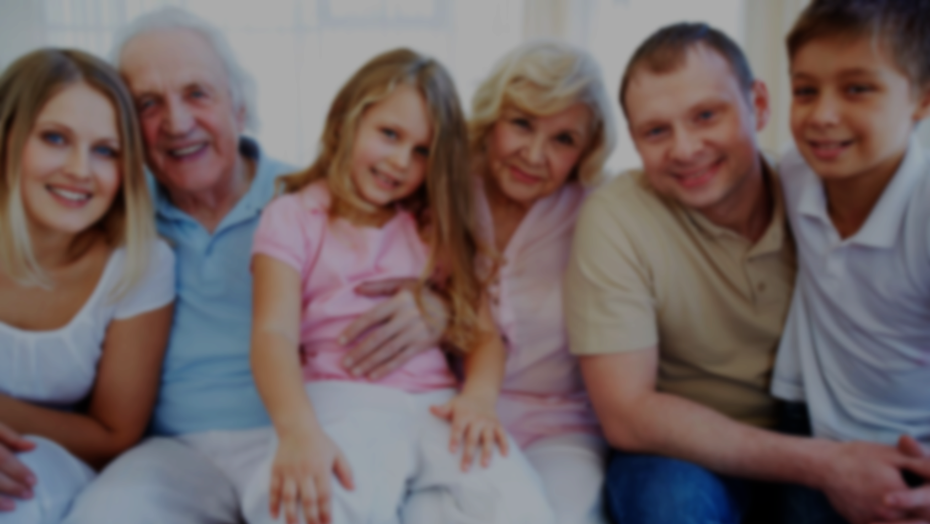
The Healthy Ageing Vision
To enable businesses, including social enterprises, to develop and deliver products, services and business models that will be adopted at scale which support people as they age. This will allow people to remain active, productive, independent and socially connected across generations for as long as possible.

Slide 3
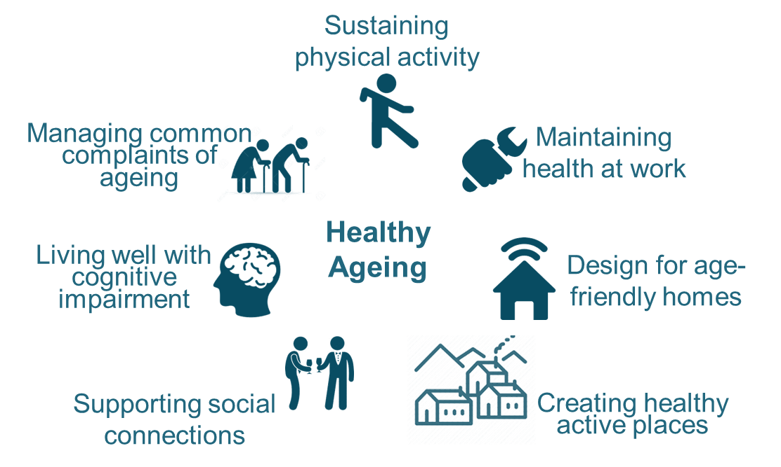
Healthy Ageing Challenge
Huge opportunities for smart services
If the ambition is to impact on the lives of millions of people within a decade:
Recognise market failures
Focus on enabling smart services
Disruptive business models are needed
While being responsible:
Recognise that citizens fear technology is an excuse for withdrawing human contact
Establish a ‘deal’ to get value from sharing data
Learn from successful outcomes-based contracting models such as the Argenti partnership in Hampshire
* The Challenge themes, developed by the Centre for Ageing Better, offer the greatest opportunities to tackle market failures and stimulate innovation
Workshop 1 24th September, 2019, AAL Forum, Aarhus, Denmark

Slide 4
© Image courtesy of NB: Studio Ltd
UKRI Website:
www.ukri.org/innovation/industrial-strategy-challenge-fund/healthy-ageing/
Workshop 1 24th September, 2019, AAL Forum, Aarhus, Denmark

